Slide 1
Product Management Agile Method
Nandagopal Govindan

Slide 2
Agenda
Agile framework
Sprint phases
Agile team structure
Product Release plan
Estimation
Sprint planning
Progress tracking
Challenges in Agile
Case study
Ref: “Agile for Dummies” by Mark Clayton

Slide 3
Introduction
Traditional software development methods such as Waterfall model have a major drawback – late detection of defects
Agile breaks the development into short-duration iterations, enabling early detection of errors
Benefits
Improved quality due to quicker feedback
Focus on business value by implementing features of greater value first
Transparency of progress

Slide 4
Agile manifesto (Agile values)
Individuals & interactions over process & tools
Working software over comprehensive documentation
Customer collaboration over contract negotiation
Responding to change over following a plan

Slide 5
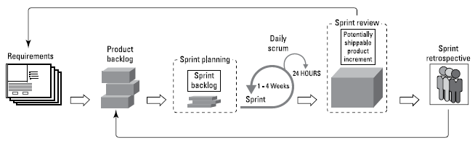
Agile framework
Source: “Agile for Dummies” by Mark Clayton

Slide 6
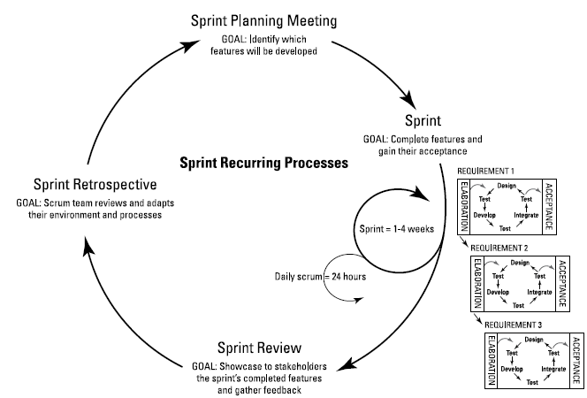
Sprint phases: Planning, Execution, Review & Retrospective

Slide 7
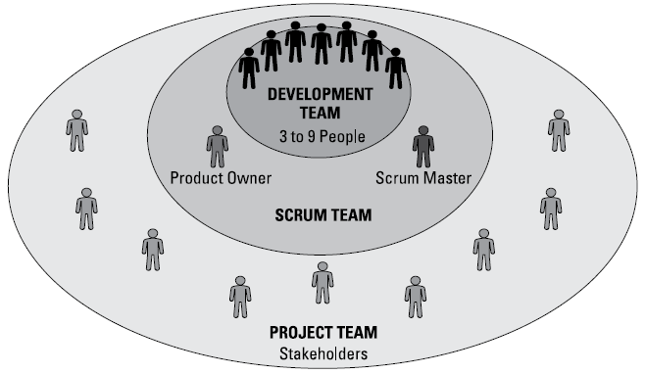
Agile team

Slide 8
Agile team: Roles and responsibilities
Product owner:
Expert in customer business need
Prioritizes requirements
Does acceptance
Scrum master / Agile coach
Expert in Agile process
Communicate with stakeholders
Clears roadblocks
Development team
Multi-skilled – set up environment, automate builds, continuous integration, refactoring

Slide 9
Experience sharing…
Did you have any other roles?

Slide 10
Product Roadmap
Steps:
Identify stakeholders.
Establish product requirements and add them to the roadmap.
Prioritize requirements based on values, risks, and dependencies.
Estimate the development effort at a high level
Determine high-level time frames for releasing groups of functionality to the customer

Slide 11
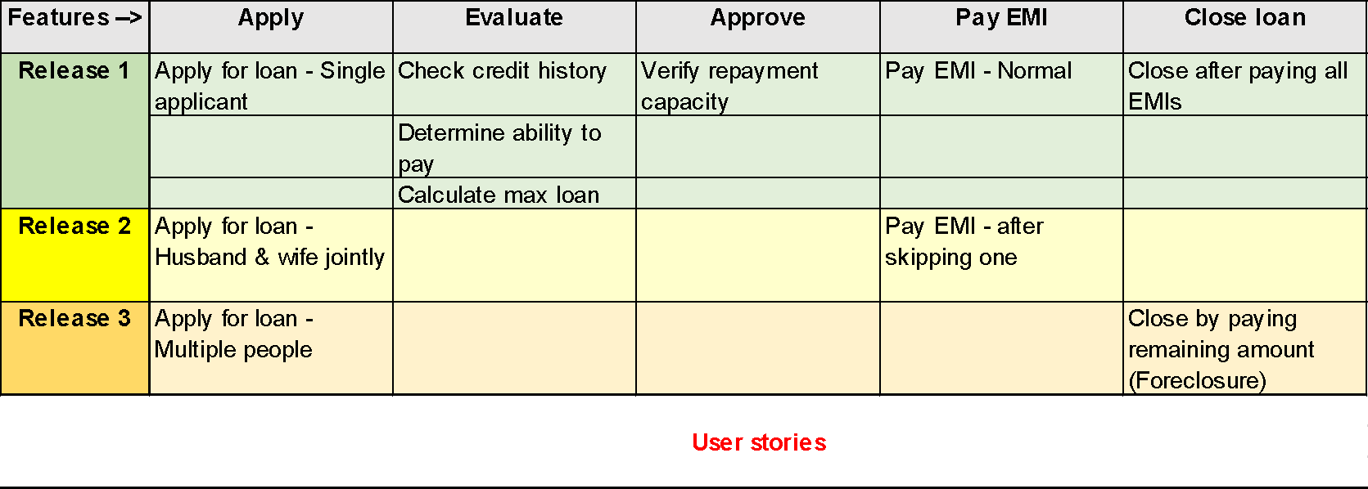
Requirements, User stories, Release plan
Home loan application

Slide 12
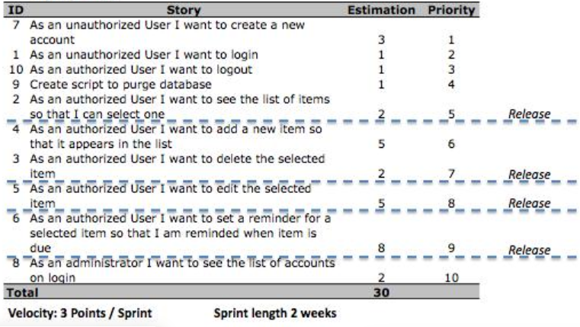
Product features, Priority, Estimation, Release plan
Source: https://www.scrum-institute.org/Release_Planning.php

Slide 13
Estimation techniques
Estimation Poker
Affinity based estimating

Slide 14
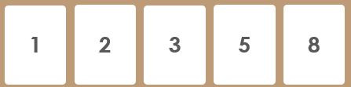
Estimation poker
Poker cards
Numbers represent relative effort of user stories
Steps:
Provide a deck of estimation poker cards.
The team agrees on one user story that would be a 5.
The product owner reads a high-priority user story
Each player selects a card representing the effort involved
If the players have different story points: discuss assumptions, re-evaluate. If members differ, breakdown the story

Slide 15
Estimation Poker
A typical deck has cards has Fibonacci sequence 1, 2, 3, 5, 8, 13
The reason for using the Fibonacci sequence instead of simply doubling each subsequent value is because estimating a task as exactly double the effort as another task is misleadingly precise
Very high numbers are not used in the deck, since it is difficult to accurately estimate a large effort
If the effort can not be estimated, the user story is broken down

Slide 16
Example of Poker estimation
Source: https://www.scrum-institute.org/Release_Planning.php

Slide 17
Exercise
Hotel Room Reservation Mobile app
Business travellers on the move, find it hard to make hotel reservation since they need to open their laptop and make reservations. It would be really convenient if a user friendly mobile app is made available by the hotel.
The UI of this mobile app should be extremely easy to use. It should support functions to Check availability of room, know the price of rooms, make a booking, etc. After their stay, the app should allow the user to provide their feedback.

Slide 18
Exercise
User stories
Room booking
Feedback
Messages from hotel
Look at booking history
Check loyalty points
Cancel booking
Request for information
Register
Login
Logout

Slide 19
Exercise
Prioritize user stories
Room booking
Feedback
View messages from hotel
Look at booking history
Check loyalty points
Cancel booking
Request for information
Register
Login
Logout

Slide 20
Exercise
Prioritized user stories
Register
Login
Logout
Room booking
Cancel booking
Look at booking history
View messages from hotel
Feedback
Check loyalty points
Request for information

Slide 21
Exercise
Create a release plan (Group user stories into releases)
Release 1
Register
Login
Logout
Room booking
Cancel booking
Release 2
Look at booking history
Messages from hotel
Release 3
Feedback
Check loyalty points
Request for information

Slide 22
Exercise
Estimate the following user stories:
Register
Login
Logout
Room booking
Cancel booking

Slide 23
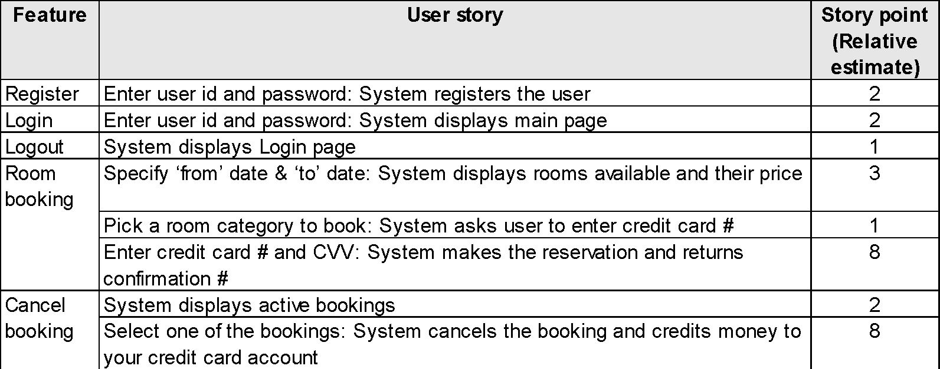
Estimation

Slide 24
Experience sharing…
Did you use this method?
If not, what method did you use?
T-Shirt sizing: Small, Medium, Large, Extra large is another way of categorizing the stories. Each size has an effort associated with it.

Slide 25
Affinity estimation
Used when user stories are many, say 500+
When you have a large number of user stories, many of them are probably similar and would require a similar amount of effort
You quickly categorize your user stories and then apply estimates to these categories of stories

Slide 26
Sprint planning
Set a goal for the Sprint
Select User stories to be developed in the Sprint
Identify the tasks for each user story – design, develop, code analysis, security hole check, test
Estimate effort for each task
Assign a person responsible for each task

Slide 27
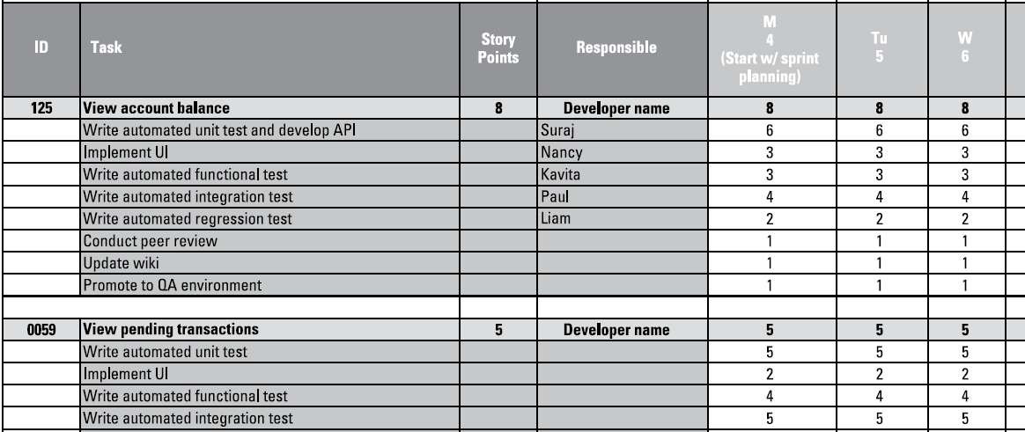
Sprint planning
Sprint goal: Demonstrate the ability of a mobile banking customer to log in and view account balances and pending and prior transactions.

Slide 28
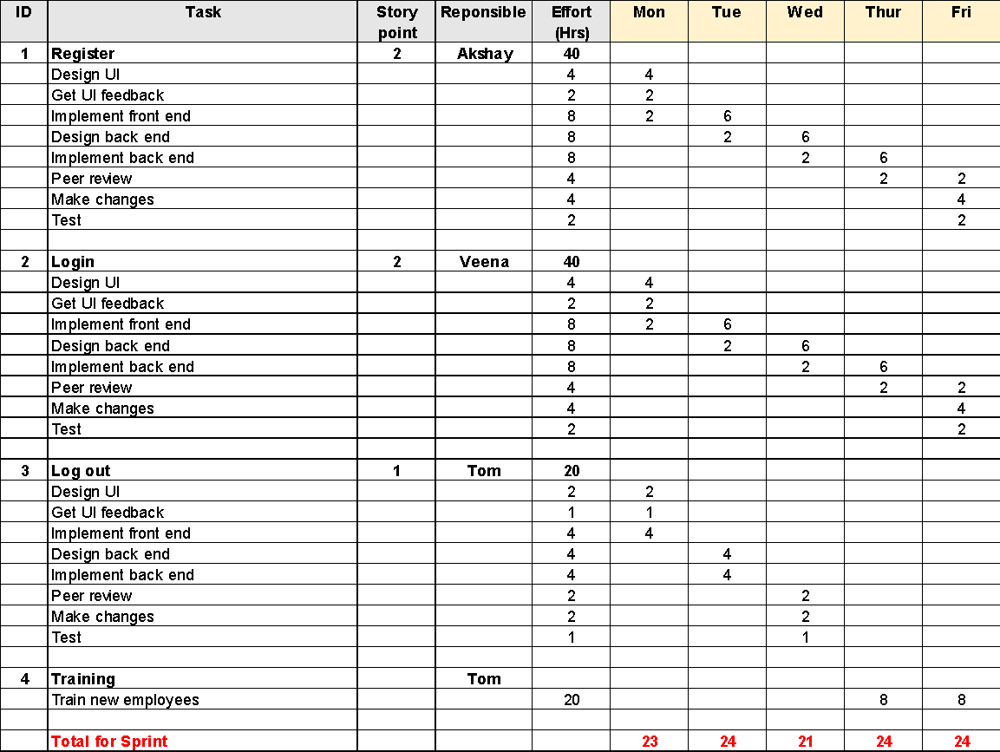
Sprint 1 plan for Hotel room reservation mobile app

Slide 29
Sprint execution
Daily scrum meeting
What was completed yesterday
What challenges were faced
What is the plan for the day
Once a week, a big picture view of the product, its goals, etc.

Slide 30
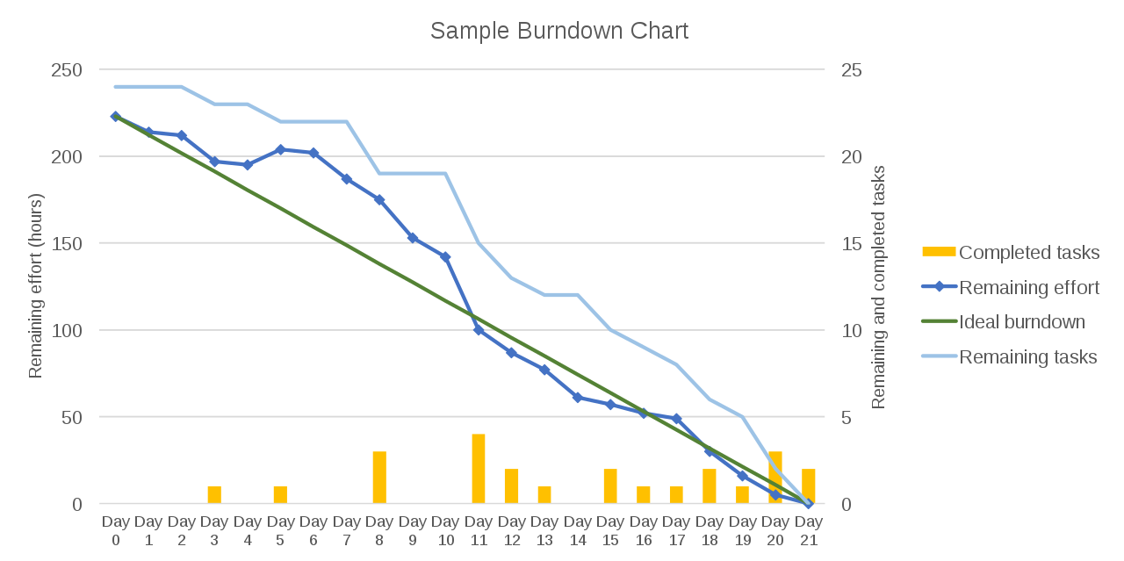
Burndown chart
JIRA provides this insight

Slide 31
Experience sharing…
How did you track progress in your project?

Slide 32
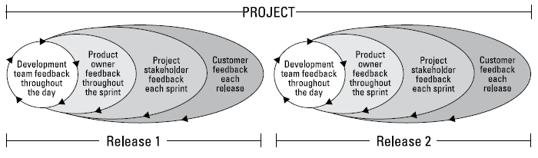
Feedback cycles

Slide 33
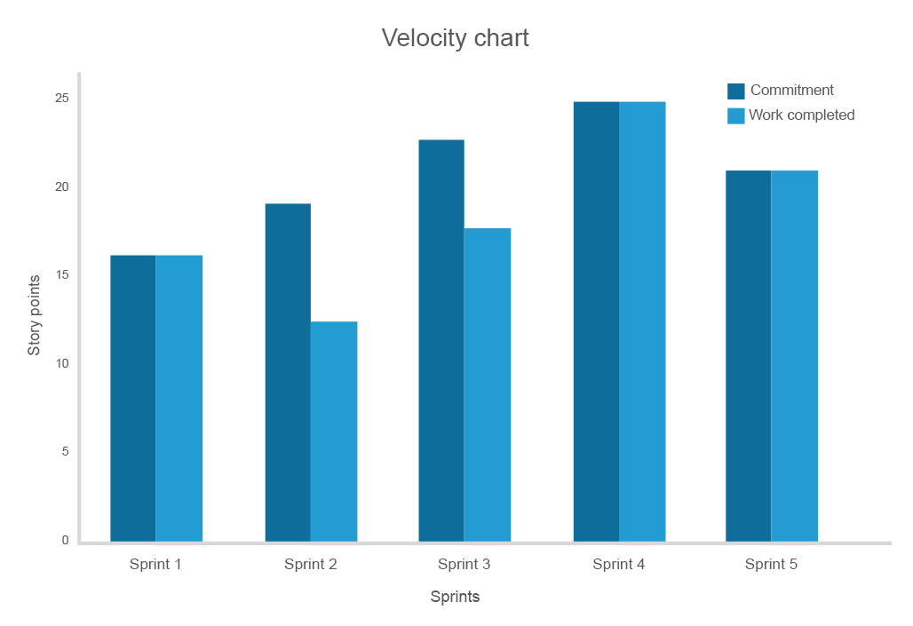
Velocity
# of story points completed per Sprint
Source: https://www.altexsoft.com/blog/business/25-scrum-process-best-practices-that-set-your-agile-workflow-for-efficiency/

Slide 34
Challenges
Lack of skilled product owners from business side
It is difficult to quote fixed price and time due to changing requirements, dependency on client in each sprint
Architectural changes and rework due to new requirements

Slide 35
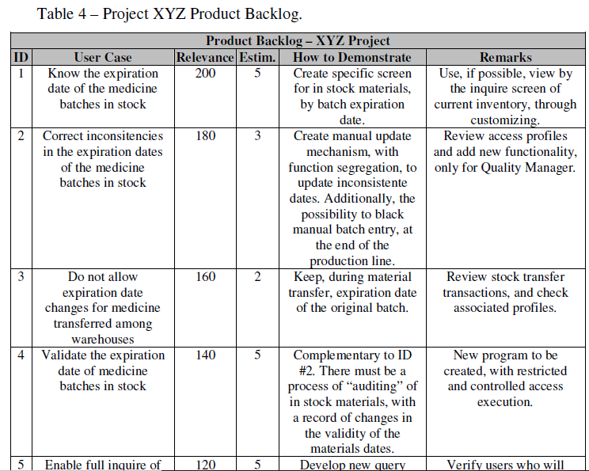
Case study: Pharma company Inventory management

Slide 36
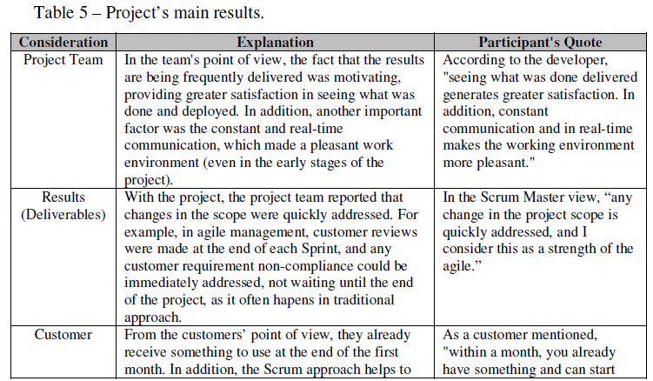
Results
5 sprints, 100 days (about 4 months). However, results used after the first month

Slide 37
Experience sharing…
What benefit did you get from Agile method?
What challenges did you face?
How did the customer / end user feel?

Slide 38
Appendix

Slide 39
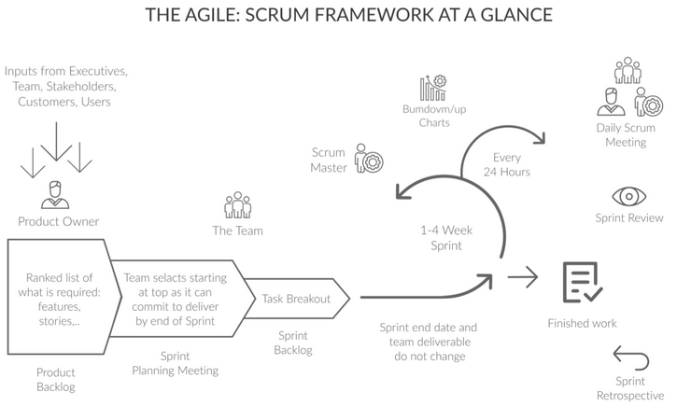
Scrum framework
https://www.altexsoft.com/whitepapers/agile-project-management-best-practices-and-methodologies/

Slide 40
Requirements, User stories, Release plan
Home loan application

Slide 41
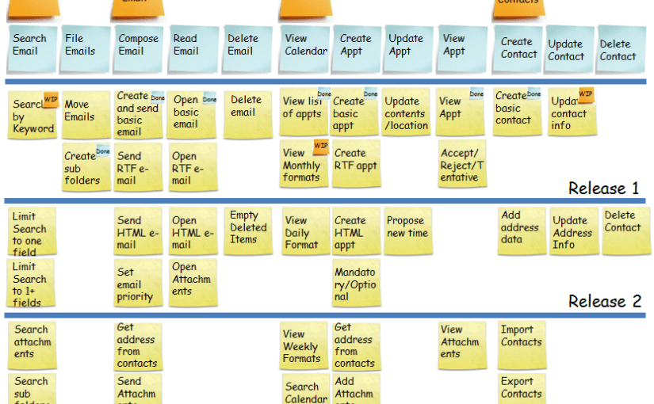
Source: https://in.pinterest.com/pin/127086020711755414/?lp=true

Slide 42
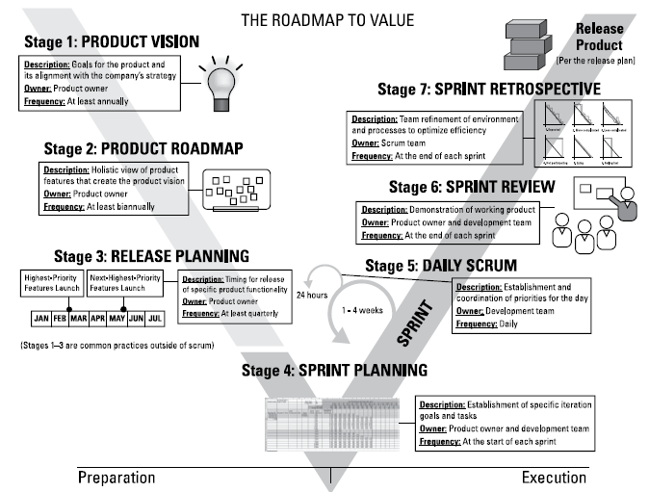
Roadmap to value

Slide 43
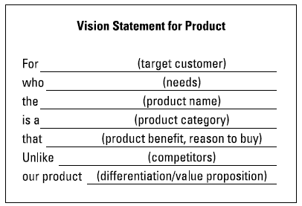
Product vision

Slide 44
Product vision: Example
For Progressive Bank customers
who want access to banking capability while on the go,
the MyProgressive
is a mobile application
that allows secure, on-demand banking, 24 hours a day.
Unlike online banking from your home or office computer,
our product allows users immediate access,
which supports our strategy to provide quick, convenient banking services, anytime, anywhere.

Slide 45
Difference between Agile and Scaled Agile
Agile projects are small 3-9 members
Scaled Agile projects have multiple Agile teams.
Coordinating different Agile teams requires additional techniques

Slide 46
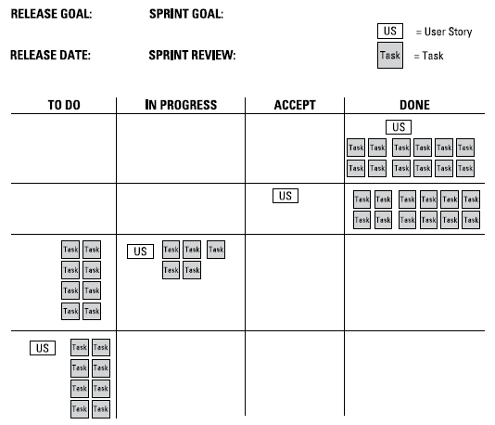
Visual progress tracking (Kanban)

Slide 47
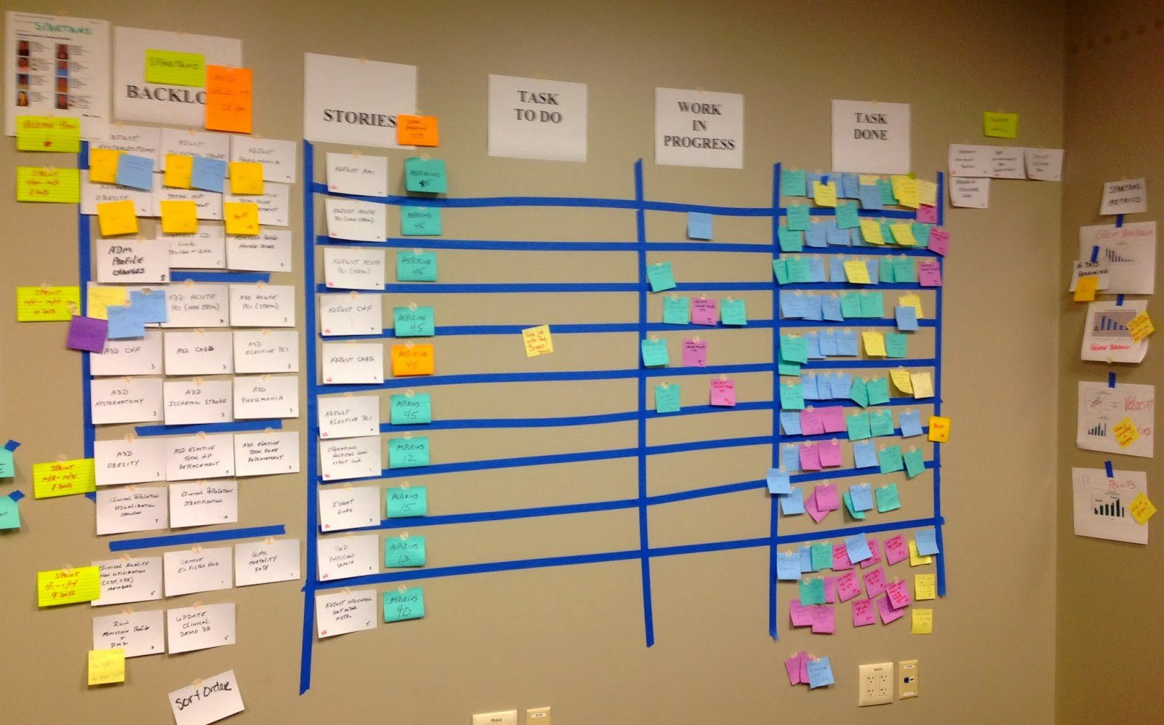
Visual progress tracking (Kanban)
Image source: medium.com/@sashabondareva

